Slide 1




TOMORROWS WORKFORCE
Peer Workforce in Alcohol & other Drugs (AOD)

Slide 2
OUTLINE
SHARC and Peer Projects
What is an AOD Peer Worker?
Why Peer Work? - The evidence base
The AOD Peer Workforce – Victoria
AOD Peer Workforce Strategy
SHARC Peer Worker Model
Implementing a Peer Workforce – Key domains
Thriving Peer Workforce
Keys to Success

Slide 3
SHARC
Self Help Addiction Resource Centre (SHARC) promotes self-help approaches to recovery from severe alcohol and drug related issues.
SHARC have been actively developing and implementing self-help and peer-support approaches to AOD recovery for over 30 years.
SHARC’s established peer workforce partnerships spread across a number of domains including justice, mental health, harm reduction and gambling related harm.
Notes:
More information about SHARC is available at the table

Slide 4

SHARC
Peer Projects, a program of SHARC, supports the growth, development and sustainability of Victoria’s AOD peer workforce. We provide:
Peer Workforce Development and Support
Services include: peer worker training, supervision, organisational readiness, resource development and facilitation of the Victorian AOD Peer Workforce Community of Practice.
We facilitate the placement and support of Peer Workers across the state in a number of environments
Notes:
More information about SHARC is available at the table
Our Peer Worker training has been evaluated by Peer Workers in Mental Health

Slide 5

WHAT is an AOD Peer Worker?
‘A Peer Worker utilises their lived experience of alcohol and other drugs, plus skills learned in formal training, to deliver services in support of others’.
Notes:
This has been developed in consultation with the CoP and DHHS – CopP will be doing a workshop
This is broad and in reality organisations requirements will differ
Looks different in a number of environments
Essentially its about connection, mutuality and empowerment
Its not about what they do but how they do it

Slide 6

WHY PEER WORK?
The evidence base for peer work is strong in the Mental Health sector and useful parallels can be drawn. (see Gagne, C. A., White, W., & Anthony, W. A. (2007). Recovery: A common vision for the fields of mental health and addictions. Psychiatric Rehabilitation Journal, 32(10), 32-37.)
New Zealand studies have evidence for AOD Peer Work. They have found it effective, good value for money a valuable component of AOD service delivery that contributes positively to people’s recovery. (See King J, Panther G. (2014). Peer Support Themes. Report prepared for AOD Collaborative Group. Auckland: Julian King & Associates Limited – a member of the Kinnect Group.)
Peer work benefits the people who use the service, the peer worker and the organisation.
Notes:
NZ - Counties Manukau Health has the highest concentration of funded AOD peer support programmes in New Zealand

Slide 7

THE AOD PEER WORKFORCE
DHHS Workforce Development has funded and supported AOD Peer Workforce Development
A clear framework for implementation and support has been developed and an annual training calendar is in place
Many organisations are formalizing and integrating peer work into their service
Collaboration with mental health to develop workforce strategies for both workforces
The Victorian AOD Peer Workforce Community of Practice is thriving

Slide 8

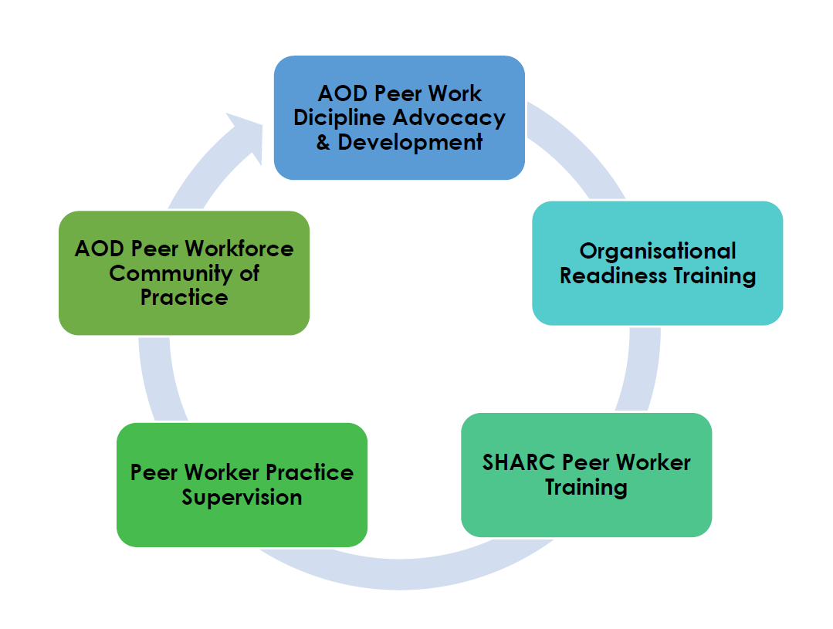
THE AOD PEER WORKFORCE
Notes:
We have developed a clear framework for implementation and sustainability of the AOD Peer Workforce

Slide 9

IMPLEMENTING A PEER WORKFORCE
Organisational Readiness
Preparation & Planning
Framework for Sustainability
Notes:
Organisational readiness
Shared understanding
Preparation and Planning
Considered planning and Human Resources practices
Framework for sustainability
Integration into organisational frameworks
Peer Worker specific supports

Slide 10

KEY DOMAINS
Organisation wide preparation is crucial for the successful implementation of a Peer Workforce. This includes:
Understanding the practice of peer work and the value it brings
Endorsement and encouragement by committees of management
Developing shared expectations about what peer workers actually do ‐ the tasks they are responsible for ‐ but more importantly, how peer workers go about their work.
Notes:
Managers and their teams are aware of, or open to, the advantages of a peer workforce
and reflected in organisational systems
Its not what they do but how they do it
We need to begin thinking about what peer work is for the whole organisation – a shared understanding is crucial

Slide 11

KEY DOMAINS
Considered planning
Development of the why and how
Liaising with other agencies and workforce development leads
4
Underpinned by considered Human Resources practices
Identification and training of staff champions
Positions are developed and operationalised in consultation with Peer Workers
Notes:
Development of the why an how. -
What do we want to achieve? How are we going to best incorporate peer work into the existing organisational infrastructure? How will peer workers complement existing roles?
Staff champions – who will be responsible for overseeing the implementation and success of the role?

Slide 12
KEY DOMAINS
Framework for sustainability
A framework for sustainability should be thought through prior to implementation. This may include:
Ensuring training and support is consistent with, and reflects, the role
Continued effort to emphasise, retain and value the distinctiveness of the peer work role
Provision of Peer Worker specific training, supervision, networking and ongoing professional development opportunities
Integration into organisational systems
Evaluation and reporting processes

Slide 13
THRIVING PEER WORKFORCE
We create more peer roles
Peer roles are well-defined and effectively recruited
Training and Policy matches expectation of roles
Managers, peers and colleagues understand the role
Peers thrive in their positions and add value for clients
Stakeholders see the value of peer workers
King and Panther (2014)
Notes:
Amongst other models…

Slide 14
Surviving PEER WORKFORCE
We create more peer roles
Peer roles are poorly defined
Training and Policy contradicts realities of the role
Managers, peers and colleagues disagree on what the role is
High turnover of peers
Stakeholders see peer workers as a liability
King and Panther (2014)

Slide 15

KEYS TO SUCCESS
Recognition at a departmental and policy level of the value
Cross sector relationships – pathways and resources for mutual learning
Resourcing Peer Workforce Development for all sectors
Notes:
Weve looked at the key domains to implementing a peer workforce. But what are keys to success for ongoing sustainability of the peer workforce across sectors?
How do we share our learnings in order to grow despite operating in different and sometimes competitive environment

Slide 16
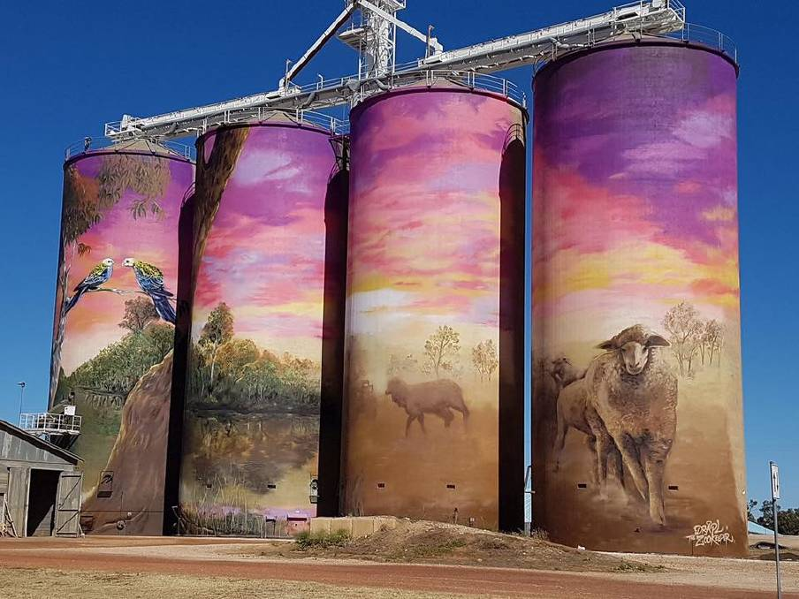
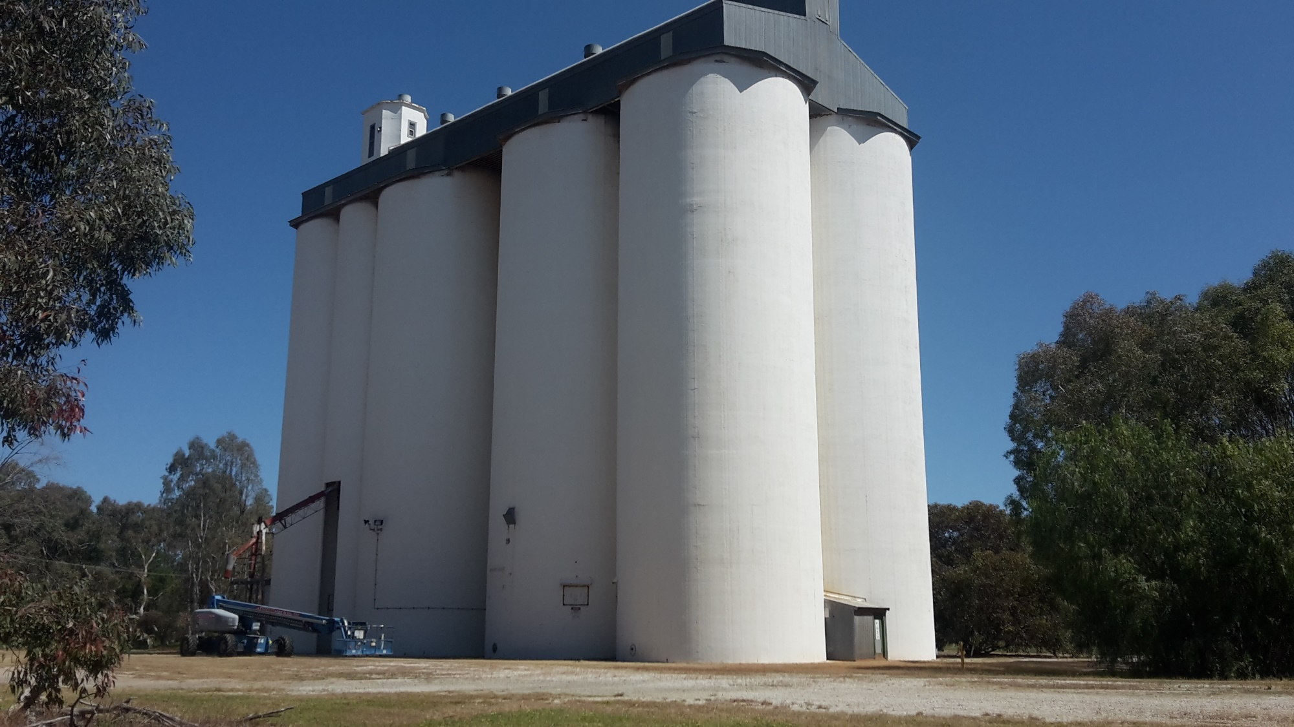
Silos

Slide 17

Questions?

Slide 18
Thank you
CONTACT
peersupport@sharc.org.au
Self Help Addiction Resource Centre Inc.
www.sharc.org.au
Peer Projects

Slide 19
REFERENCES
King J, Panther G. (2014). Peer Support Themes. Report prepared for AOD Collaborative Group. Auckland: Julian King & Associates Limited – a member of the Kinnect Group.
Commonwealth of Australia, Department of the Prime Minister and Cabinet, National Ice Action Strategy 2015
Gagne, C. A., White, W., & Anthony, W. A. (2007). Recovery: A common vision for the fields of mental health and addictions. Psychiatric Rehabilitation Journal, 32(10), 32-37.
State of Victoria, Department of Health and Human Services, July 2018. Victoria’s alcohol and other drugs workforce strategy 2018–2022.
State of Victoria, Department of Health and Human Services, May 2013 Victorian Alcohol and Drug Treatment Principles.
Intergovernmental Committee on Drugs, July 2014, National Alcohol and other Drug Workforce Development Strategy 2015–2018 (A Sub-strategy of the National Drug Strategy 2010–15)

